Slide 1
CS Curriculum@UC
An Outline

Slide 2
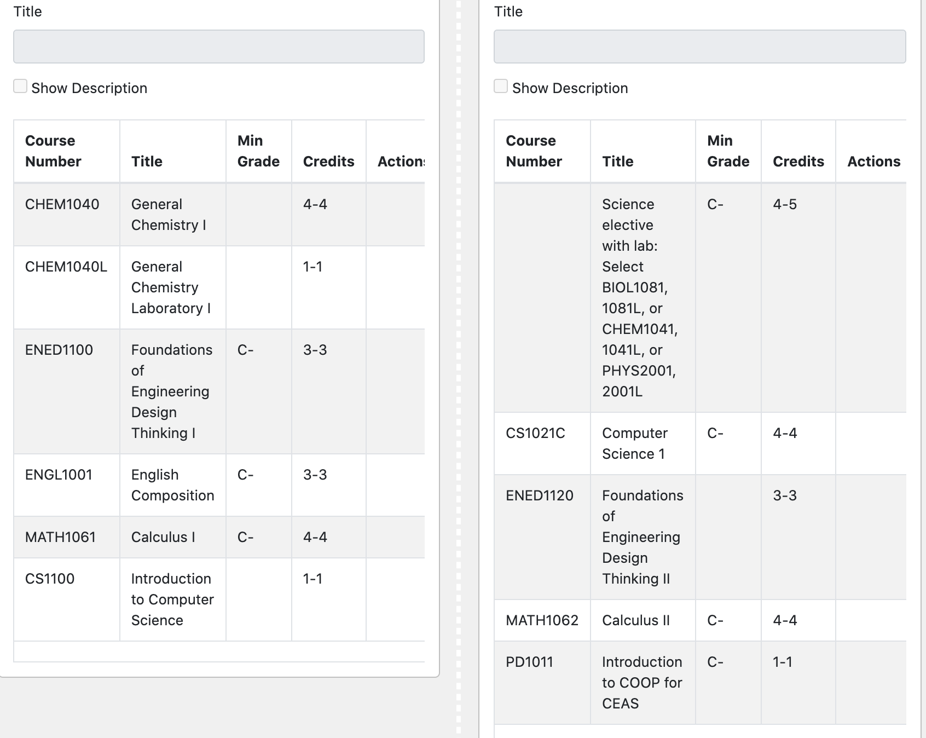
Year1: The first two semesters
CS1021C: Computer Science I
Introduction to programming in C++
Object-Oriented programming
Lab-based course

Slide 3
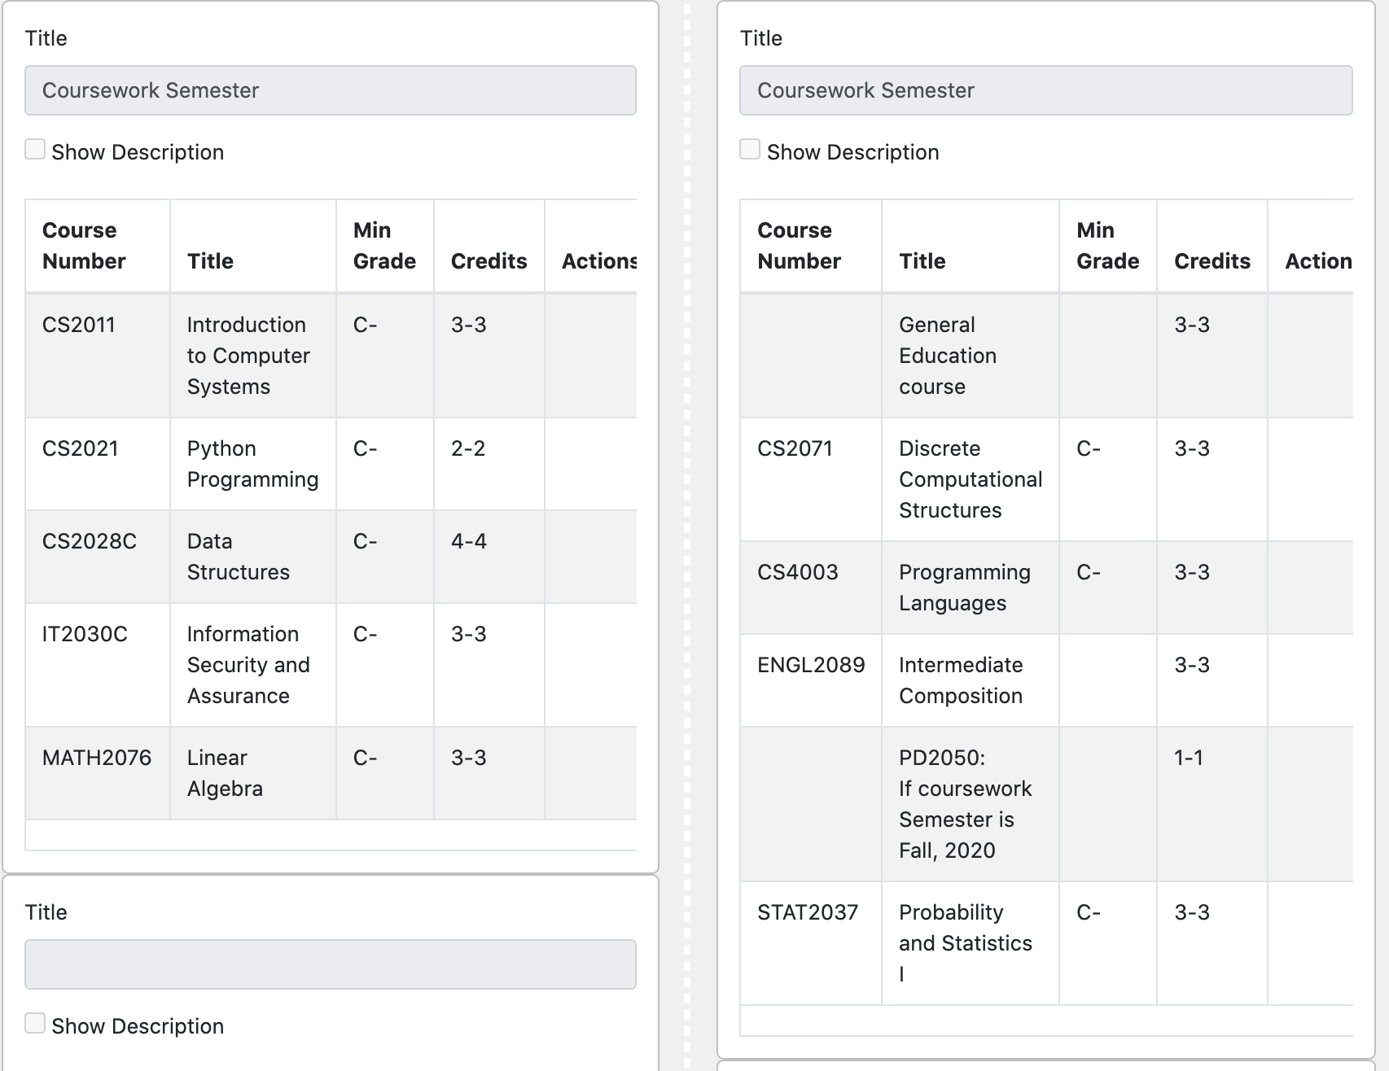
Sophomore Year
CS2011: Introduction to Computer Systems
Basic ideas of building a computer system
Assembly-level (Machine-level) architecture of a computer

Slide 4
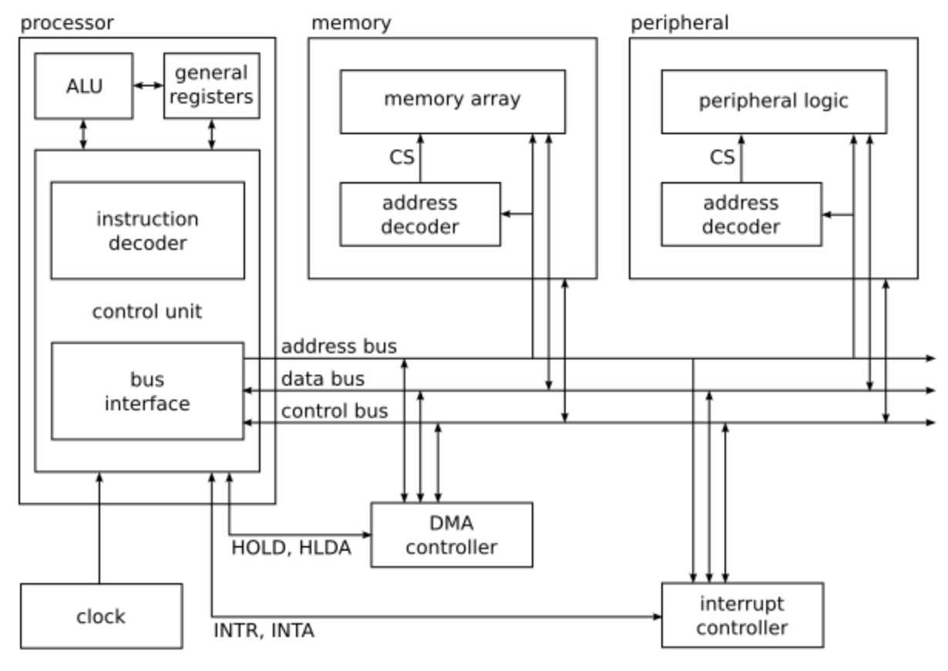
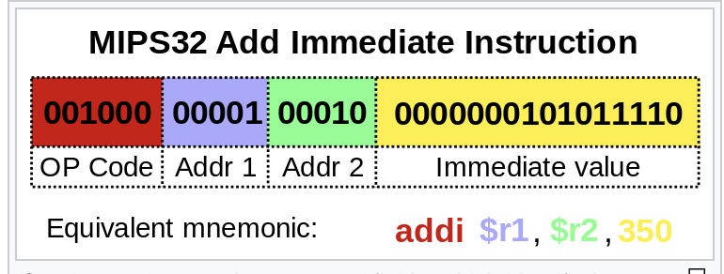
CS2011: Introduction to Computer Systems
Basic ideas of building a computer system
Assembly-level (Machine-level) architecture of a computer
Instruction Format

Slide 5
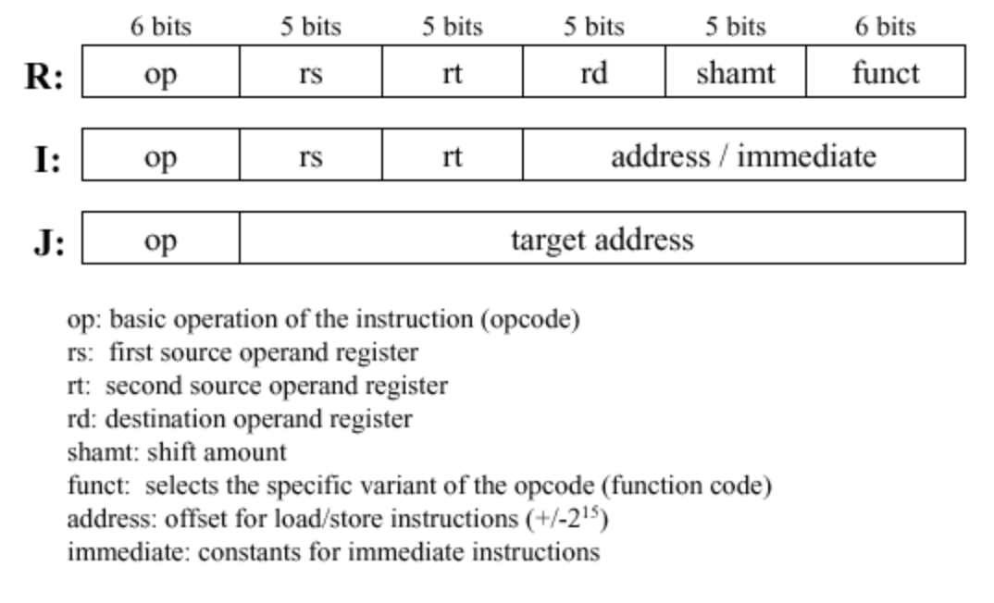
CS2011: Introduction to Computer Systems
Basic ideas of building a computer system
Assembly-level (Machine-level) architecture of a computer
Multiple Instruction Formats

Slide 6
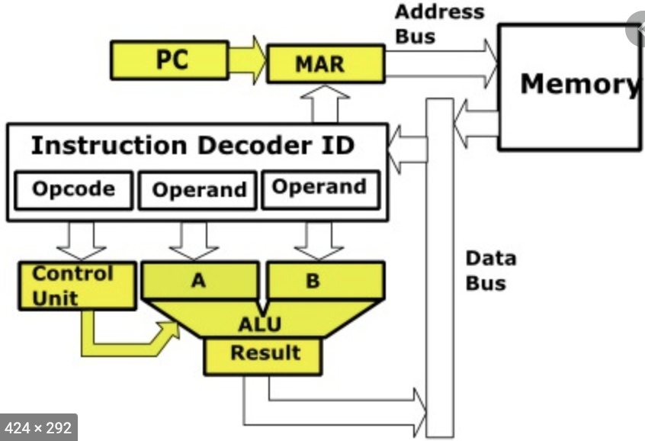
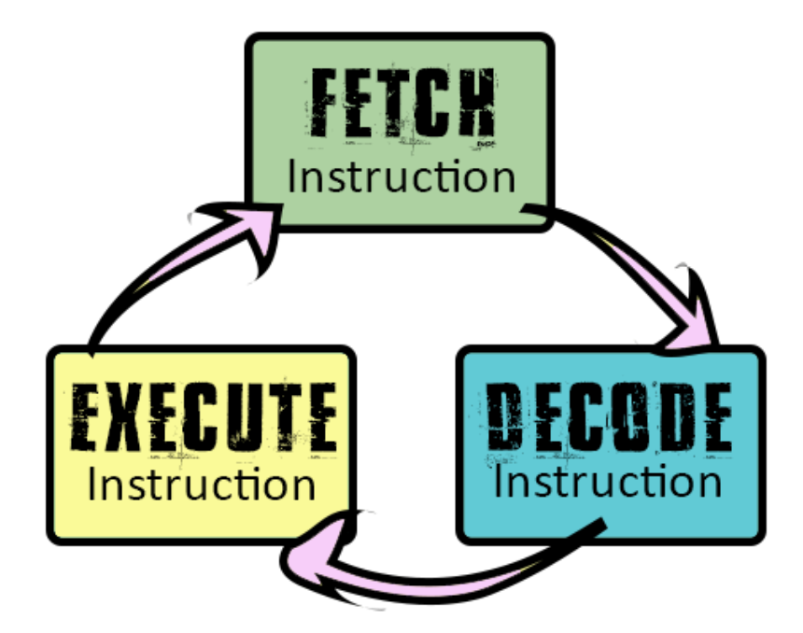
CS2011: Introduction to Computer Systems
Basic ideas of building a computer system
Assembly-level (Machine-level) architecture of a computer

Slide 7
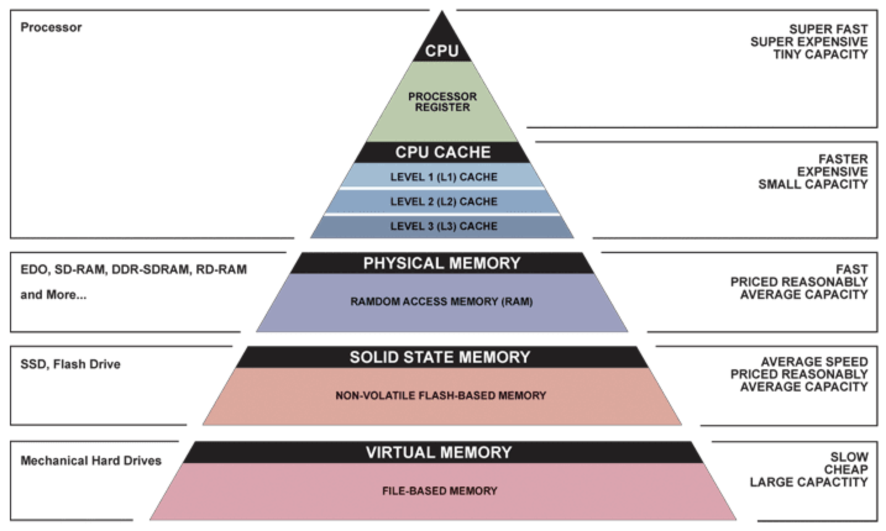
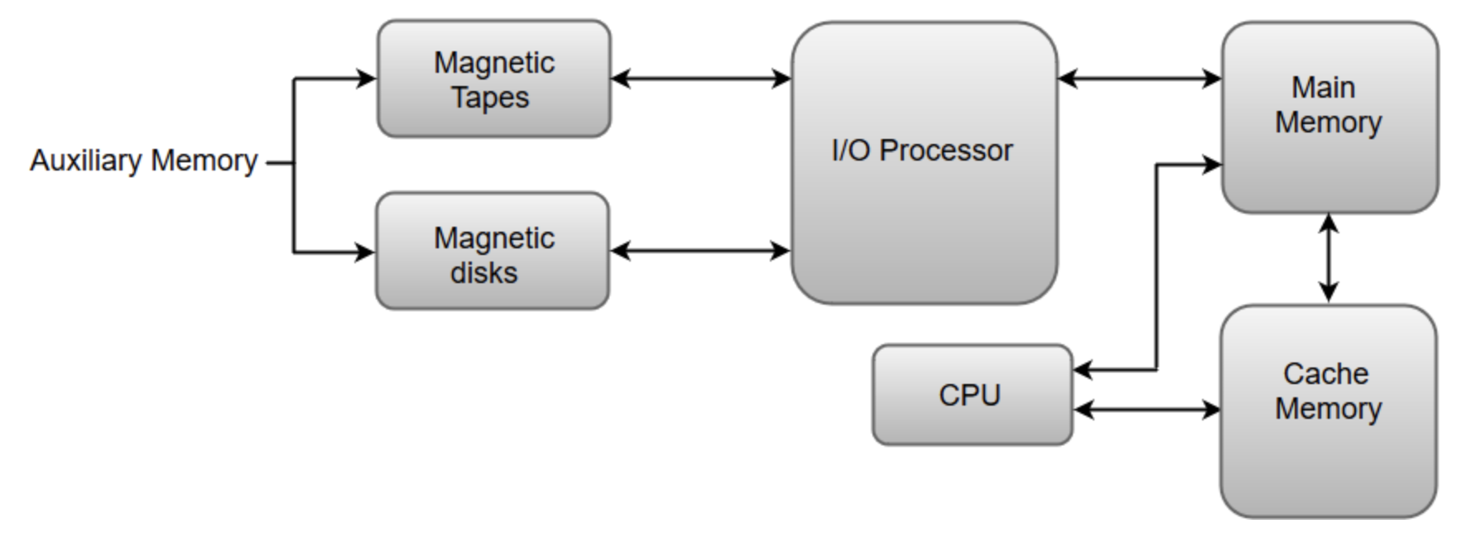
CS2011: Introduction to Computer Systems
Memory Hierarchy:

Slide 8
Sophomore Year

Slide 9
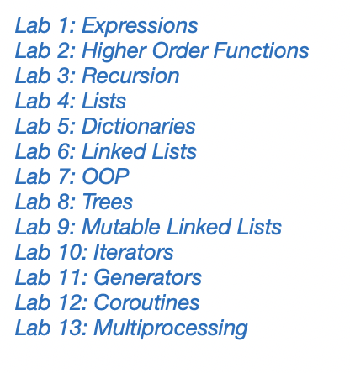
CS2021: Python Programming

Slide 10
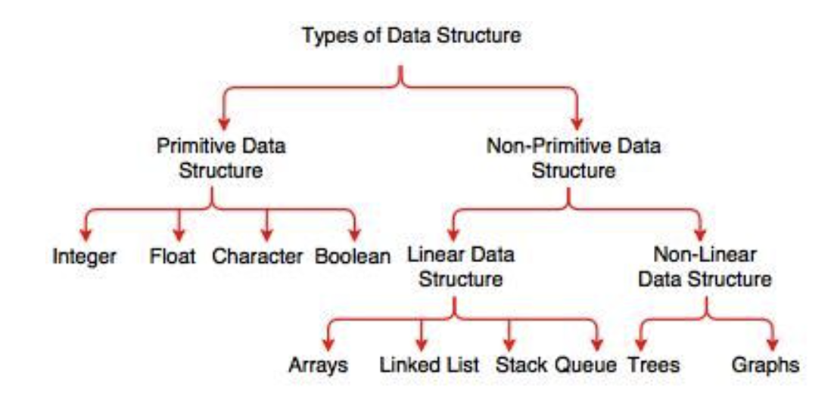
CS2028C: Data Structures

Slide 11
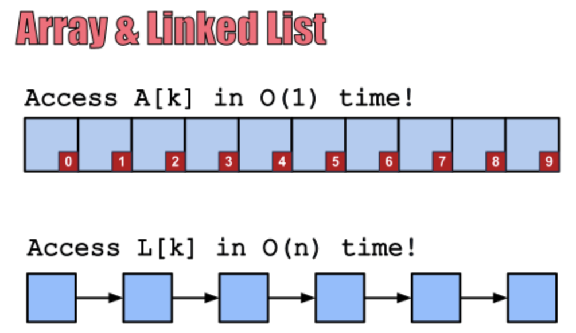
CS2028C: Data Structures

Slide 12
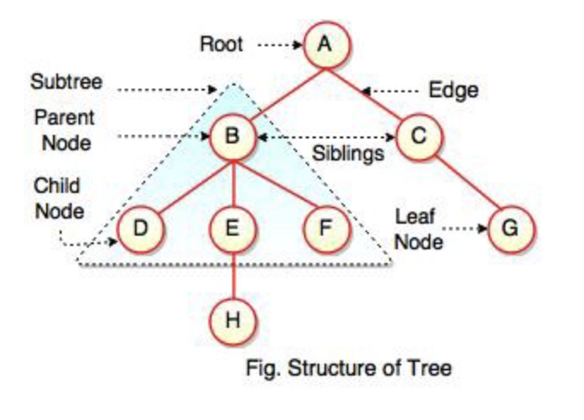
CS2028C: Data Structures - Trees

Slide 13
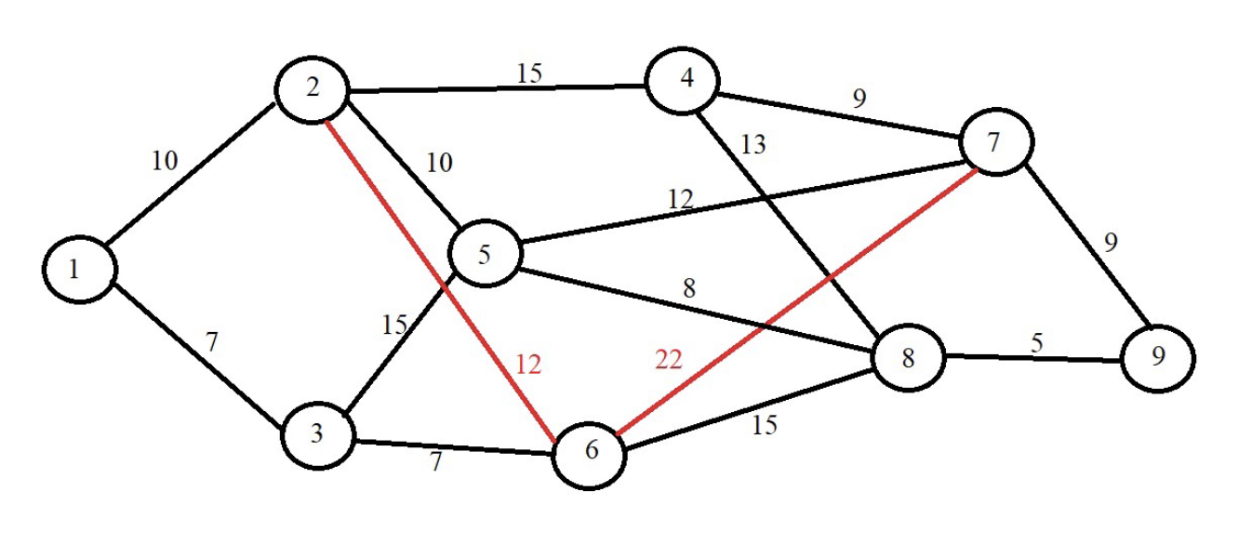
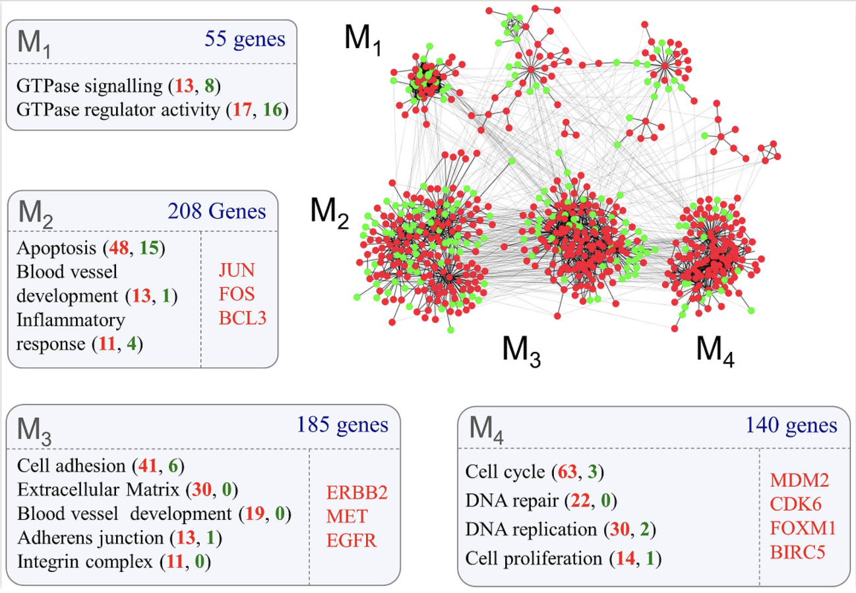

CS2028C: Data Structures - Graphs
Social Networks
LinkedIn
Facebook

Slide 14
Sophomore Year

Slide 15
IT2030C: Information Security and Assurance
Topics Covered:
Protection of information systems
Levels of protection for different systems
Response strategies for Security violation incidents
Intrusion detection strategies
Design considerations for a security system

Slide 16
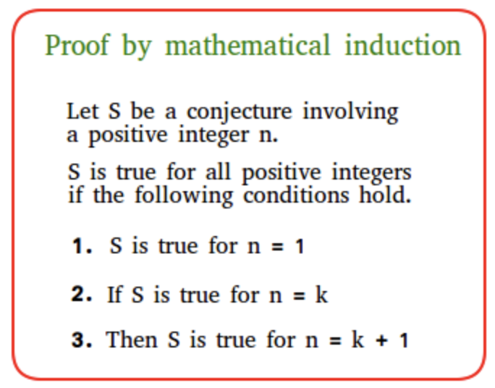
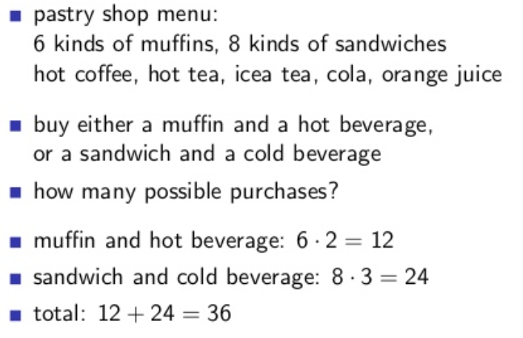
CS2071: Discrete Structures
Topics Covered:
Proof Methods
Direct Proof
Proof by Contradiction
Proof by Induction
Counting Methods/Rules
Sum/Product rules
Permutations/Combinations
Pigeonhole principle

Slide 17
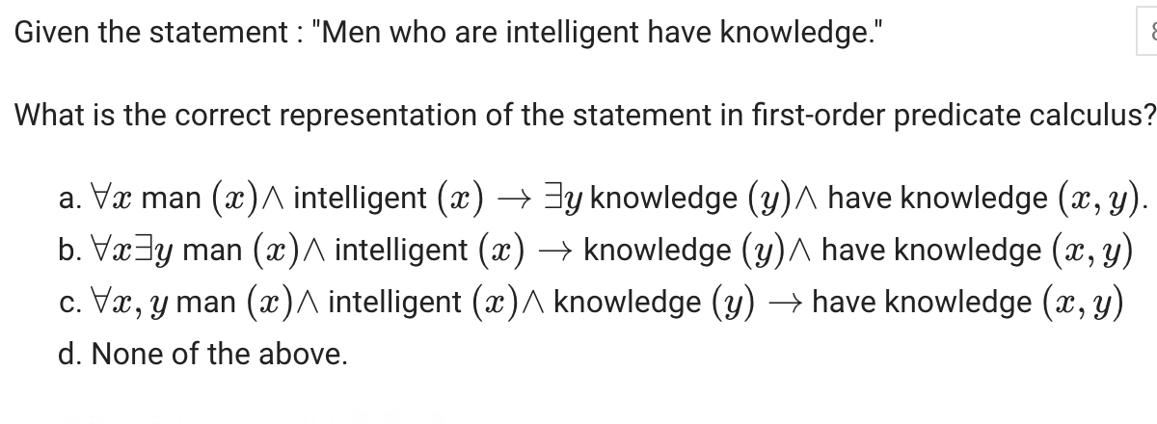
CS2071: Discrete Structures
More Topics Covered:
Propositional Logic
First Order Predicate Calculus
How to represent knowledge formally
Inference Methods for represented knowledge

Slide 18
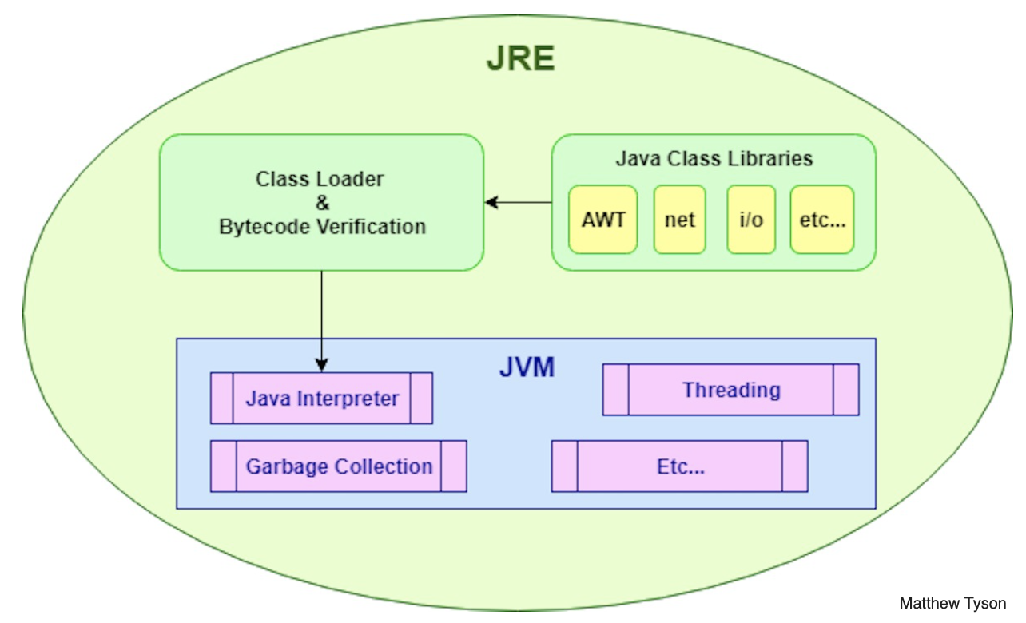
CS4003: Programming Languages
How Programming Languages Work at Run Time?
Procedural Languages
Functional Languages
Logic Programming Languages
How is a program executed by the computer
Memory organization/management
How function calls are managed
How recursion is managed
How parameters are passed to functions

Slide 19
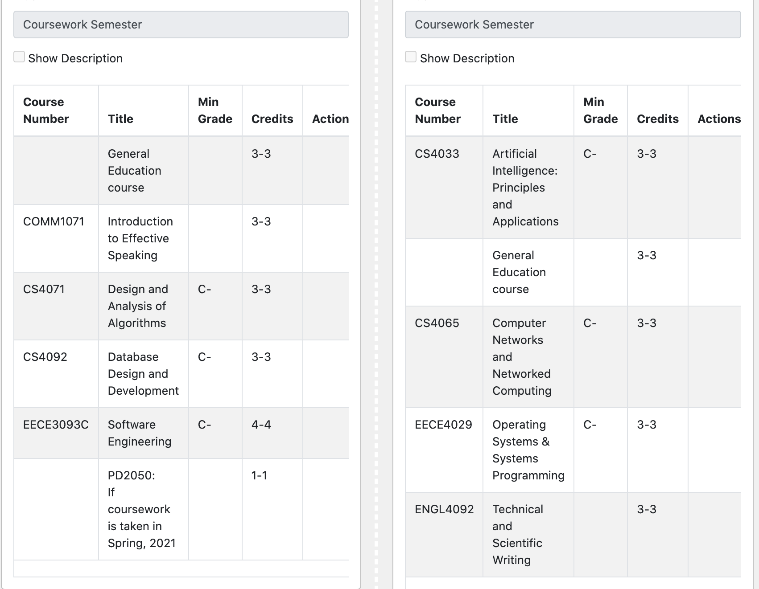
Pre-Junior / Junior Years

Slide 20
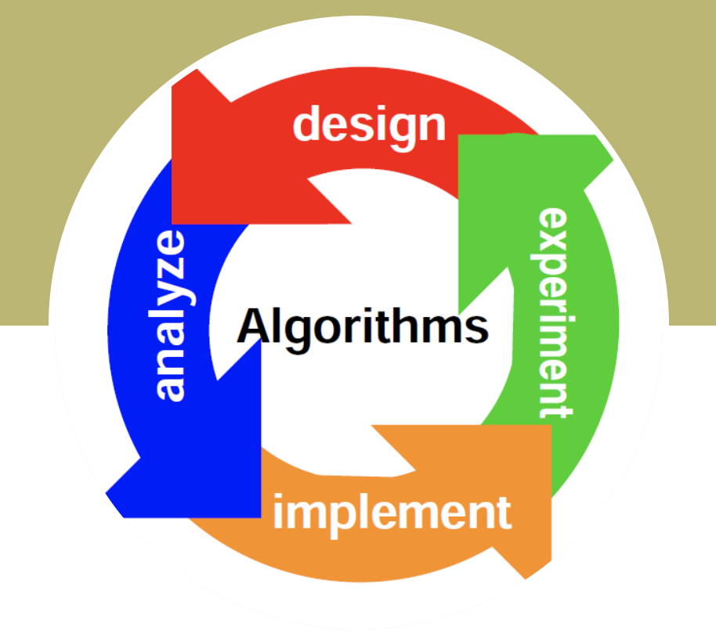
CS4071: Design and Analysis of Algorithms
Topics: Role of algorithm in computing Divide and Conquer algorithms Sorting complexity, heapsort, quicksort Binary Search Trees, Red-Black Trees Dynamic Programming Greedy Algorithms Elementary graph theory, minimum spanning trees, single source shortest paths, all pair shortest paths, maximum flow Polynomials and FFT NP completeness

Slide 21
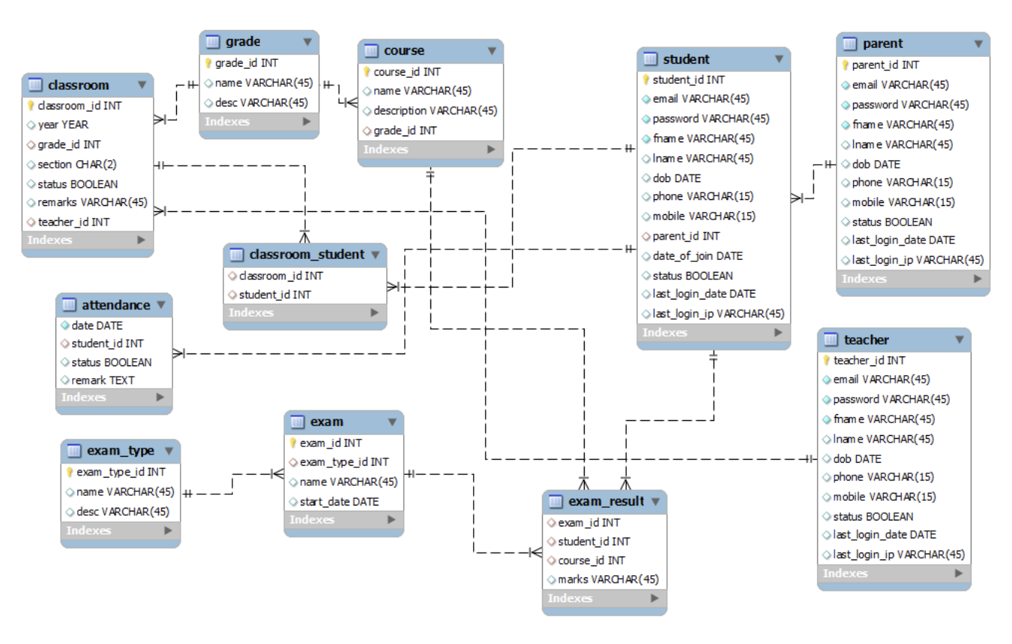
CS4092: Database Design and Development
Topics:
1. Architecture and usage of DBMSs
2. Physical storage: file structures, indexing, hashing (static and dynamic)
3. Entity-relationship model: application design
4. Relational model: schema development and query specification
5. Formal query languages (relational algebra and tuple calculus)
6. Query optimization (logical and physical)
7. Functional dependencies and normalization
8. Transactions: recovery and concurrency
9. XML data modeling and web-based database design and development

Slide 22
EECE3093C: Software Engineering
Topics:
introduce various approaches and methodologies for software development
different phases of software development lifecycle, including:
requirements analysis
specification,
software design,
software construction,
software testing, and
software maintenance
A project and team-based class, has programming lab hours

Slide 23

CS4033: Artificial Intelligence: Principles and Applications
Topics:
Problem solving by searching
Many interesting problems do not have efficient algorithms
Knowledge Representation and Reasoning
Logical representation
Uncertainty information
Machine Learning
Decision Trees
Reinforcement Learning

Slide 24
CS4065: Computer Networks and Networked Computing
Topics:
Introduction to Computer Networking
7-Layer Architecture of networks
Routing and Forwarding of packets
Local Areas Networks
Parallel and Distributed Computing
Distributed Systems
Consensus protocols

Slide 25
EECE4029: Operating Systems
Topics:
Job and processor scheduling
Scheduling algorithms
Concurrent processes and critical sections
Memory organization and management
File organizations
Distributed systems

Slide 26
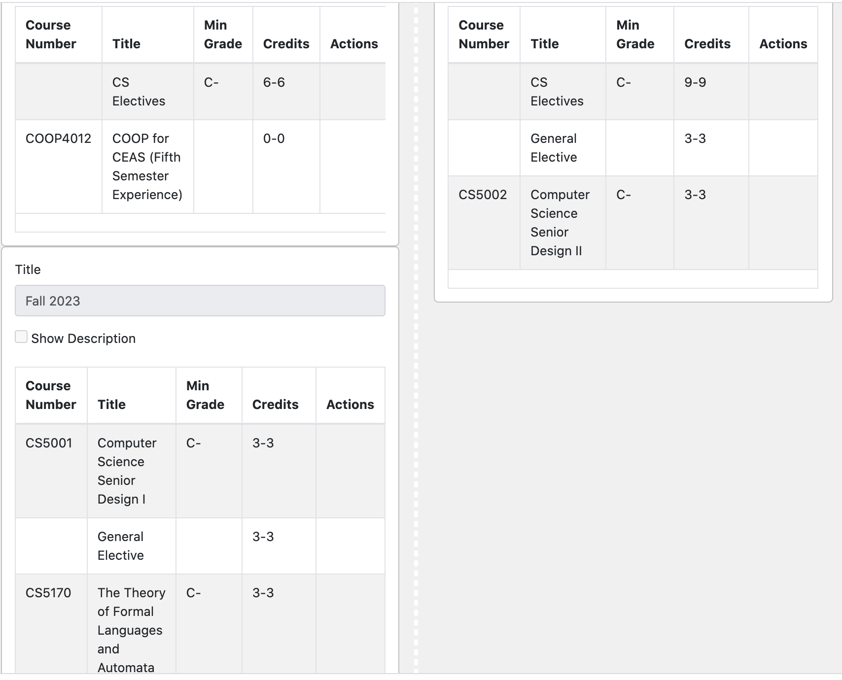
Senior Year

Slide 27
CS5001/CS5002: Senior Design
2-semester long capstone project
Teams of 2-4 students
A project to be designed and implemented
Training in the design process
Collaboration among team members
Some projects are inter-disciplinary
A demo of the project at the end of the Spring semester

Slide 28
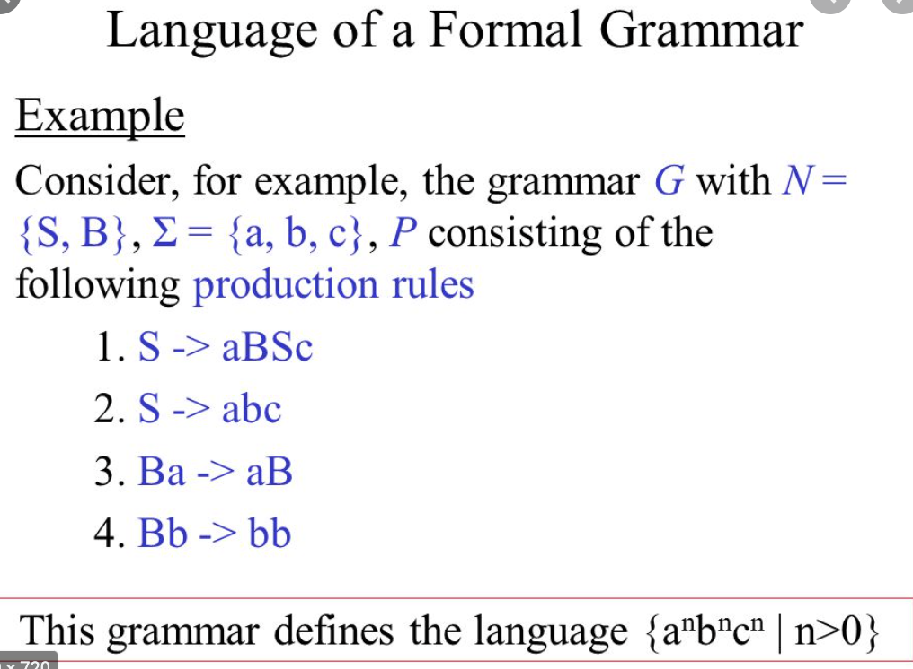
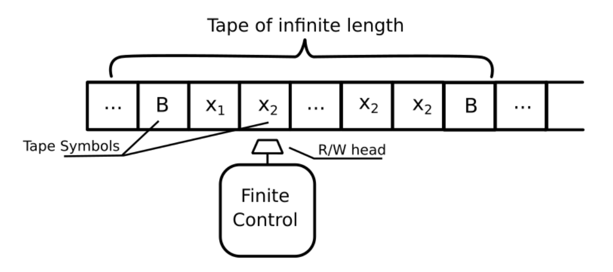
CS5170: Theory of Formal Languages and Automata
Topics:
Formal Languages,
Formal Grammars
Automata Theory
Context free languages
Computability – theoretical ideas
Turing machine
Limits of algorithmic computing

Slide 29
CS Electives
5 courses, 15 credits
CS51xx numbered courses
~40 different approved courses on books
~8-10 different courses are offered each semester
In all areas of specializations
Software engineering
Artificial Intelligence/Machine Learning
Cybersecurity
Design and analysis of Algorithms
Database Management/Theory

